Slide 1

Optimal Policies and Value Function
Notes:
1

Slide 2
Objectives
Define an optimal policy
Understand an optimal value function
Understand how to use optimal value function to get optimal policies
Optimal Policies and Value Function
2
Notes:
2

Slide 3
Optimal Policies
The role of policies in Reinforcement Learning (RL) is pivotal as they dictate the behavior of an agent within its environment.
Action Selection: Policies determine how an agent selects actions in different states of the environment.
Learning Objective: Policies define the learning objective for the RL agent.
Exploration vs. Exploitation: Policies balance exploration and exploitation
Optimal Policies and Value Function
3
Notes:
3

Slide 4
Optimal Policies
The role of policies is pivotal as they dictate the behavior of an agent within its environment.
Evaluation of States and Actions: Policies implicitly or explicitly evaluate states and actions based on their expected rewards.
Adaptation to Changing Environments: Policies allow RL agents to adapt to changes in the environment.
Generalization: Policies can facilitate generalization across similar states.
Optimal Policies and Value Function
4
Notes:
4

Slide 5
Optimal Policies
The role of policies is pivotal as they dictate the behavior of an agent within its environment.
Representation of Knowledge: In some RL algorithms, policies serve as a representation of the agent's knowledge about the environment.
Policy Improvement: In iterative RL algorithms like policy iteration or actor-critic methods, policies are updated iteratively to improve performance.
Optimal Policies and Value Function
5
Notes:
5

Slide 6
Policies Types
Deterministic Policy: for each state, the agent selects a single action with certainty.
Stochastic Policy: the agent selects actions based on a probability distribution over possible actions for each state.
Optimal Policy: the policy that yields the highest expected cumulative reward over time.
Optimal Policies and Value Function
6
Notes:
6

Slide 7
Optimal Policies
It refers to the policy that maximizes the expected cumulative reward over time.
It is the policy that the RL agent should follow in order to achieve the best possible performance in the given environment.
The optimal policy can be learned through various RL algorithms: Q-learning, policy gradient methods, and deep reinforcement learning methods.
Optimal Policies and Value Function
7
Notes:
7

Slide 8
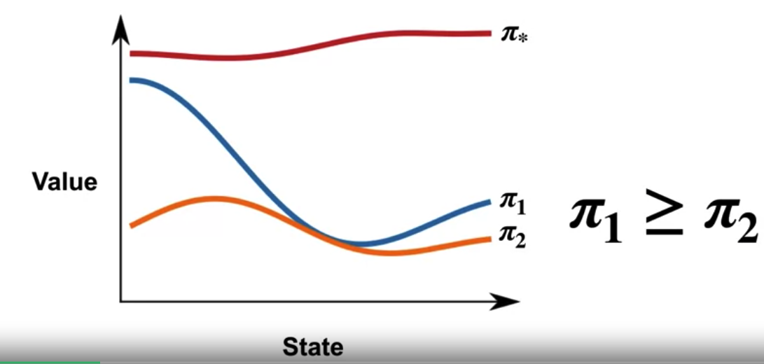
Optimal Policies
An optimal policy Pi star is as good as or better than all the other policies
Optimal Policies and Value Function
8
Notes:
8

Slide 9
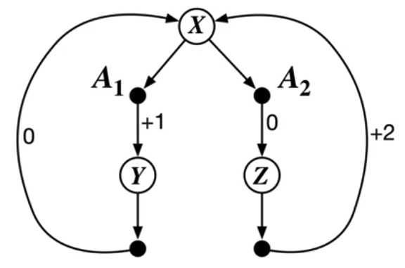
Optimal Policies
Example to build some intuition about optimal policies.
The two choice MDP
From state X: action A1→ the agent to state Y. In state Y, only action A1 → agent back to state X.
From state X: action A2→ the agent to state Z. From state Z : action A1 → back to state X.
The numbers show the rewards the agent receives after each action.
Optimal Policies and Value Function
9
Notes:
9

Slide 10
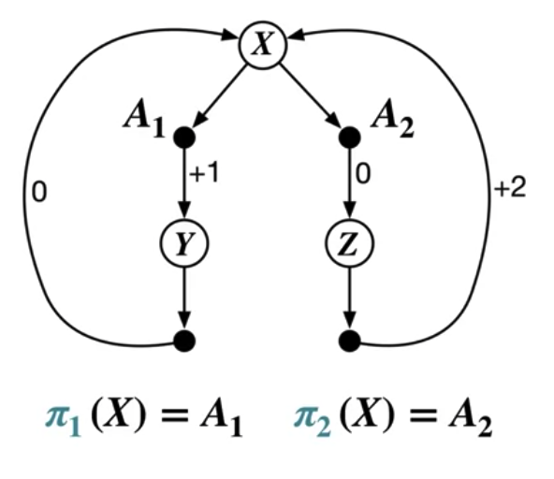
Optimal Policies
Two deterministic policies: Pi1 and Pi2
Which of these two policies is optimal?
Optimal Policies and Value Function
10
Notes:
10

Slide 11
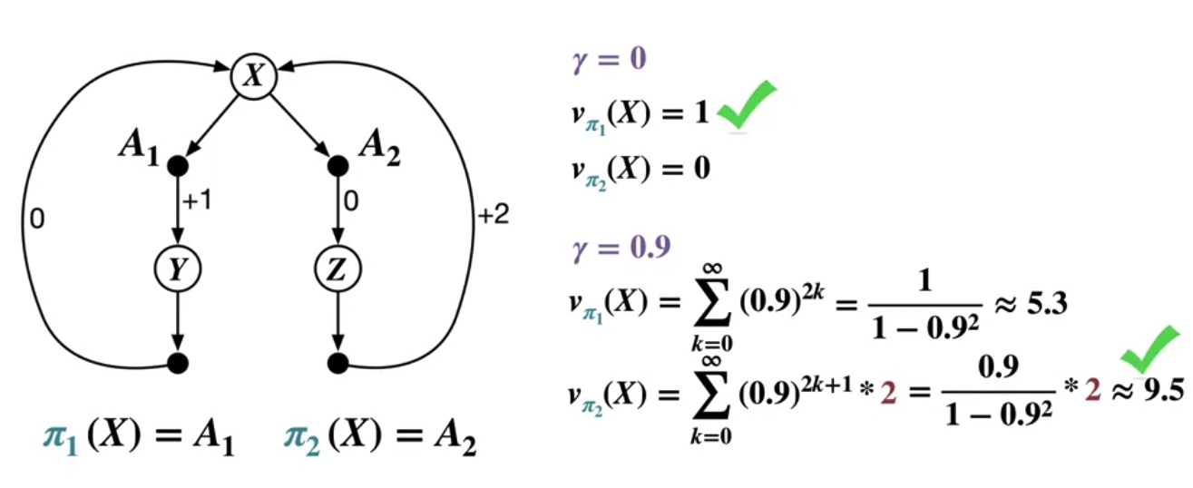
Optimal Policies
Depends on the discount factor Gamma.
Optimal Policies and Value Function
11
Notes:
11

Slide 12
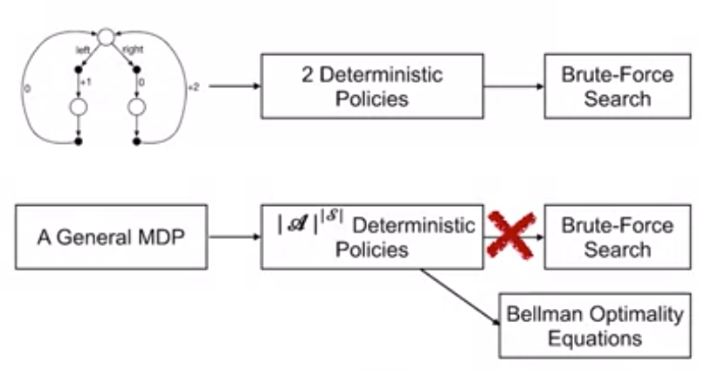
Optimal Policies
However we can only directly solve small MDPs
Optimal Policies and Value Function
12
Notes:
12

Slide 13
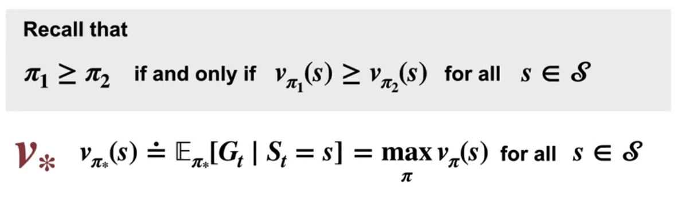
Optimal Value Function
The value function for the optimal policy thus has the greatest value possible: V star
Optimal Policies and Value Function
13
Notes:
13

Slide 14
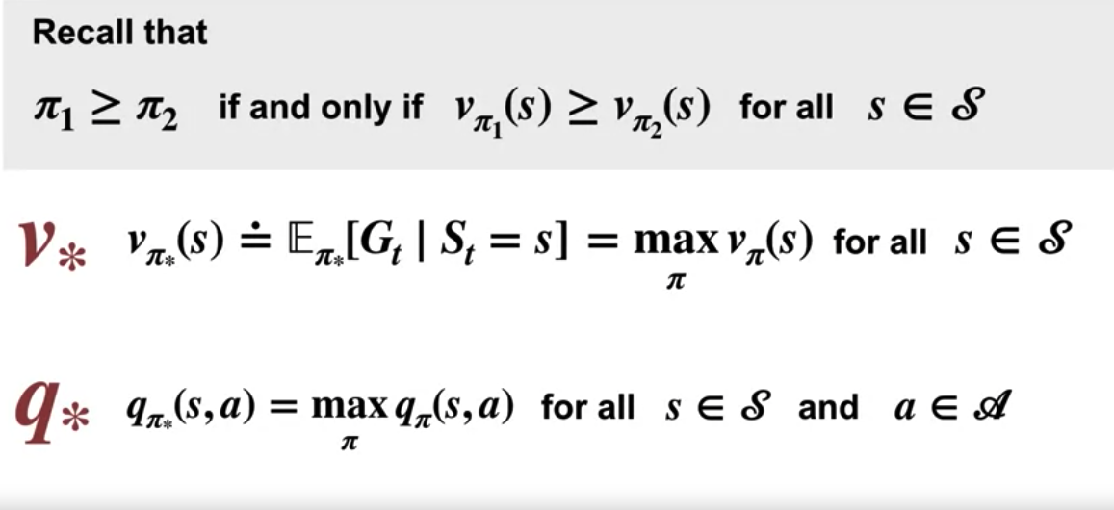
Optimal Value Function
The shared action value function by q star.
Optimal Policies and Value Function
14
Notes:
14

Slide 15
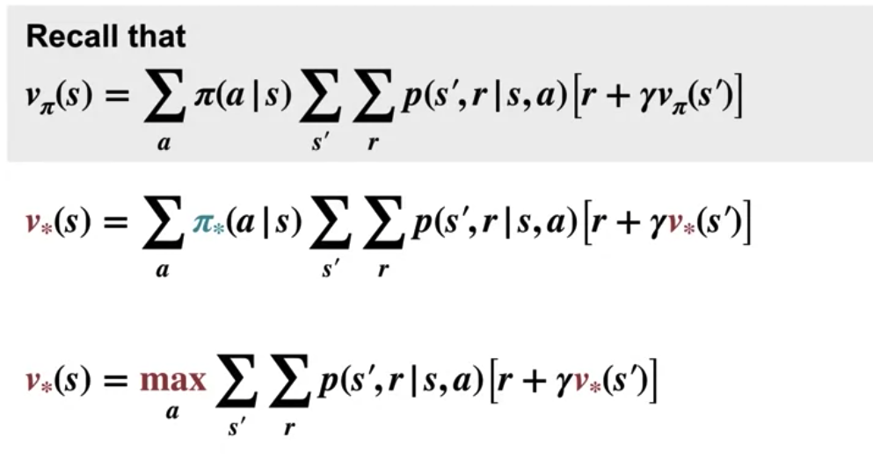
Optimal Value Function
We can rewrite the equation in a special form, which doesn't reference the policy itself. This is Bellman Optimality Equation for V star
Optimal Policies and Value Function
15
Notes:
15

Slide 16
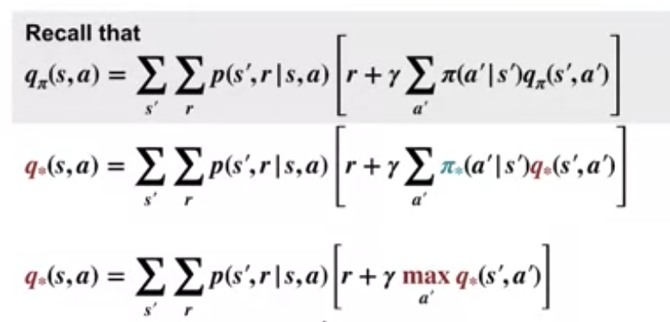
Optimal Value Function
The Bellman Optimality Equation for q star
Optimal Policies and Value Function
16
Notes:
16

Slide 17
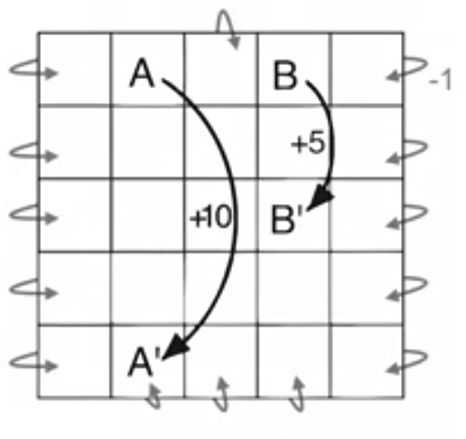
Relationship
Example
All actions in state A transition to state A prime with a reward of +10.
State B, all actions transition to B prime with a reward of +5.
The reward is zero everywhere else except for -1, for bumping into the walls
Optimal Policies and Value Function
17
Notes:
17

Slide 18
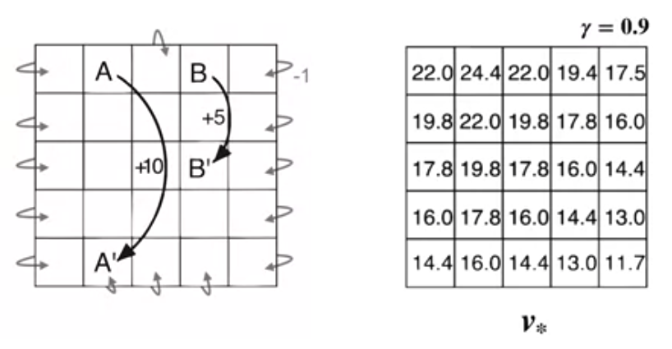
Relationship
The discount factor is 0.9
The associated optimal values for each state.
Optimal Policies and Value Function
18
Notes:
18

Slide 19
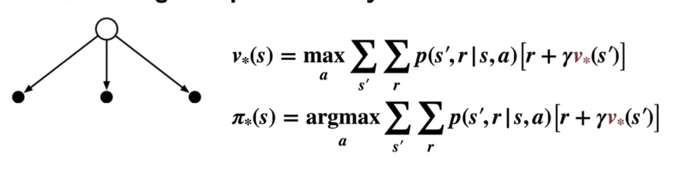
Relationship
v star is equal to the maximum of the boxed term over all actions.
Pi star is the argmax, which simply means the particular action which achieves this maximum.
Optimal Policies and Value Function
19
Notes:
19

Slide 20
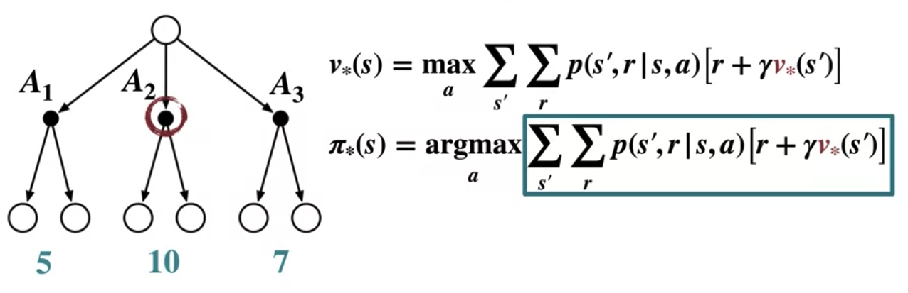
Relationship
We can determine an optimal policy
Optimal Policies and Value Function
20
Notes:
20

Slide 21
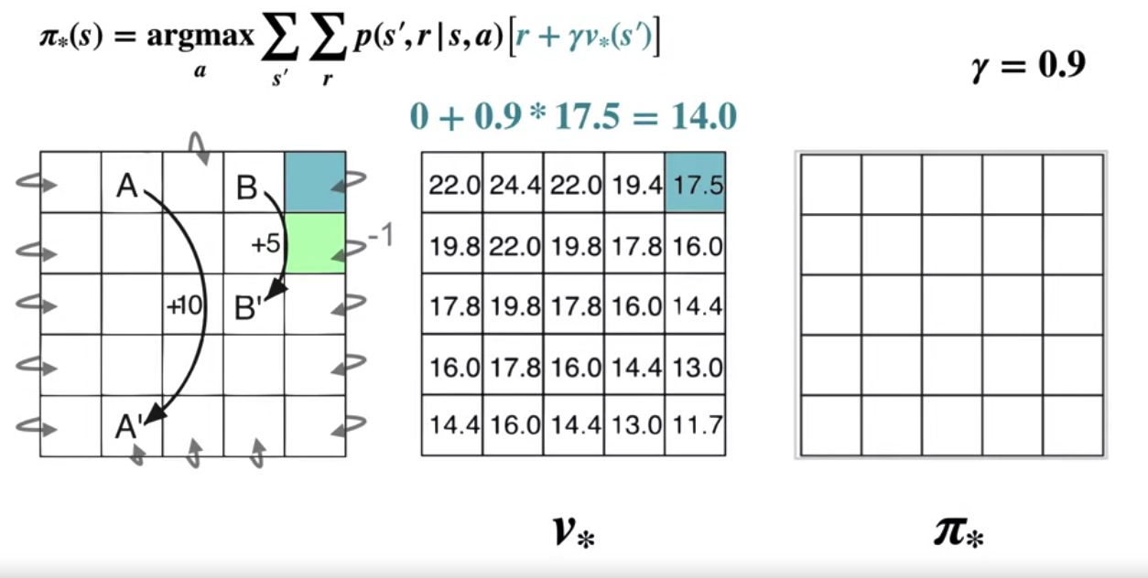
Relationship
Calculate
Optimal Policies and Value Function
21
Notes:
21

Slide 22
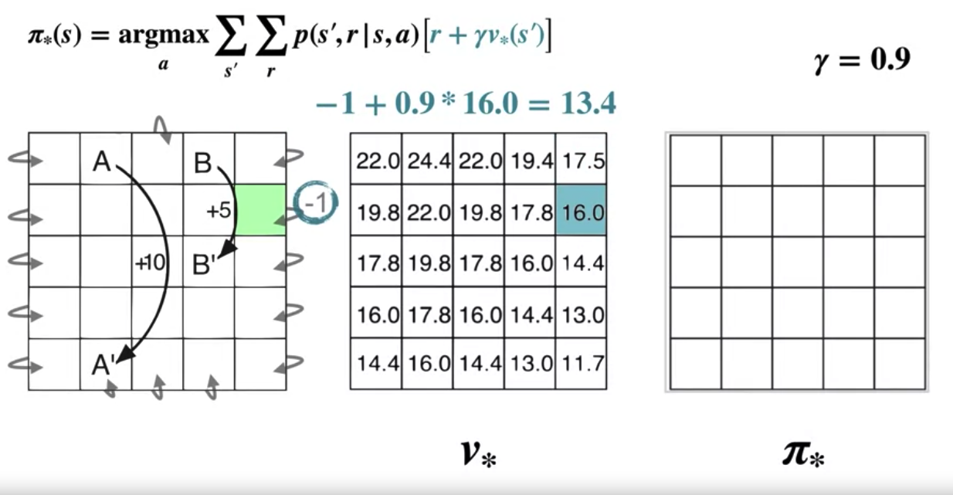
Relationship
Calculate
Optimal Policies and Value Function
22
Notes:
22

Slide 23
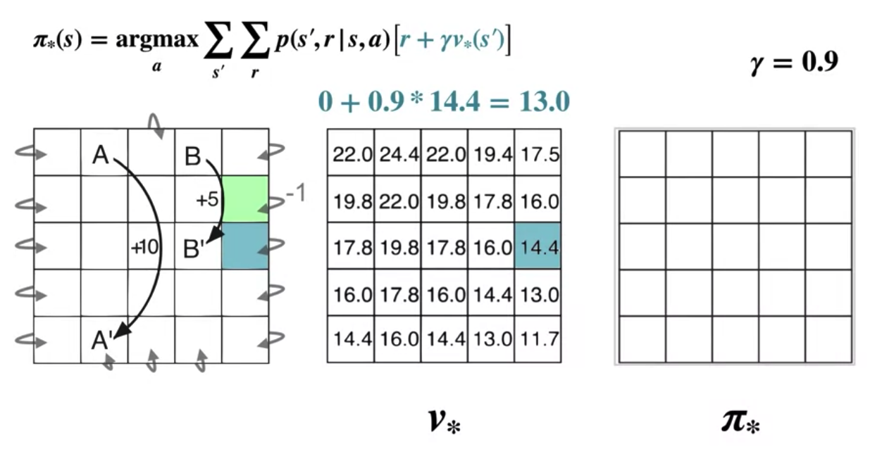
Relationship
Calculate
Optimal Policies and Value Function
23
Notes:
23

Slide 24
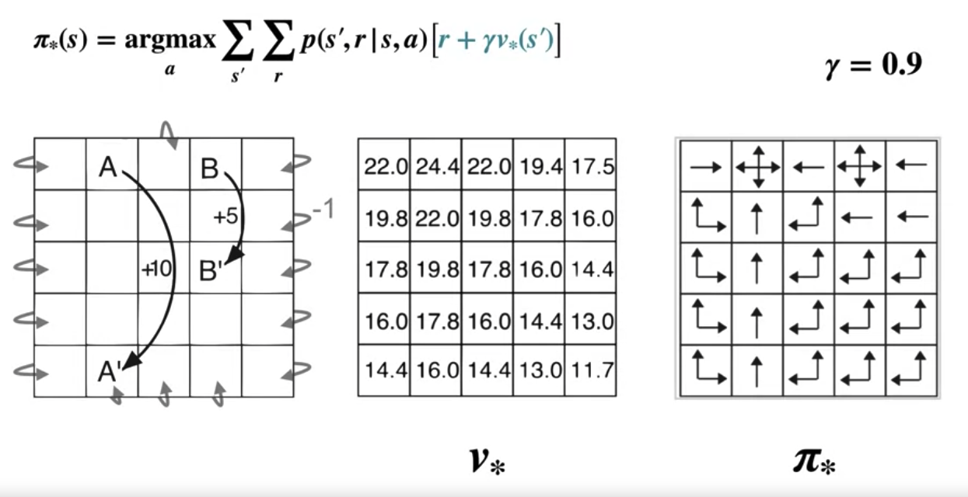
Relationship
Finding the optimal policies
Optimal Policies and Value Function
24
Notes:
24

Slide 25
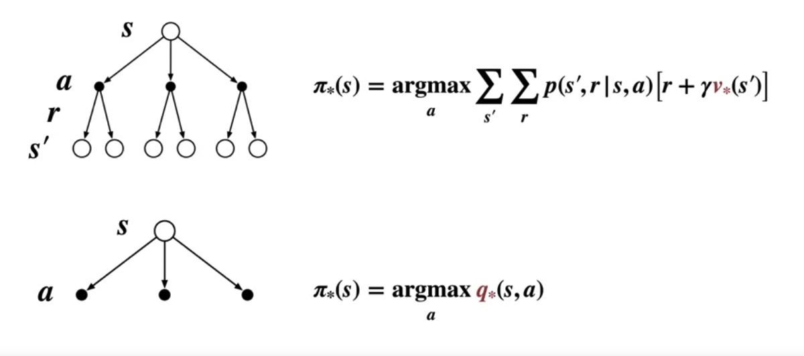
Relationship
Determining an optimal policy
Optimal Policies and Value Function
25
Notes:
25

Slide 26
Relationship
Relationship between Value Function and Optimal Policies
The value function provides information about the expected return that an agent can achieve from different states
Optimal policies dictate the best actions to take in each state to maximize the expected return.
The value function provides critical information about the expected return from different states, which guides the selection of actions in order to derive optimal policies that maximize the cumulative reward over time.
Optimal Policies and Value Function
26
Notes:
26

Slide 27
Summary
Define an optimal policy
Understand an optimal value function
Understand how to use optimal value function to get optimal policies
Optimal Policies and Value Function
27

Slide 28
Q & A
Optimal Policies and Value Function
28

